Slide 1
Module 3 - Marketing your maple syrup products: What should you consider?
By
Tom Hammett and Cindy Martel
Appalachian Program
Future Generations University
supported by the
USDA AMS-ACER
Access Grant Program
Notes:
Welcome to Future Generations University’s business learning modules for maple enterprise development. This module will provide an introduction to marketing - an important part of your enterprise development. We would like to acknowledge the programs that have assisted us assembling this information, particularly the USDA AMS-ACER Access Grant Program as well as the resources developed by other maple development programs.
Please remember that this module is not intended to advise you on how to conduct your business. As in other modules we encourage you to determine what will work best for your situation. Hopefully this module will provide answers to some of your questions and needed resources in the area of marketing. So, get your pen and paper ready, and put on your thinking cap!

Slide 2
Before you start this module ….
Download this module’s worksheet
Become familiar with the learning objectives
Have handy your business planning notebook
Consider working on this module with members of your team
Get a resource that will help define basic marketing terms
Notes:
Before you move forward, please make sure you have a hard copy or access to the worksheet for this module. It is downloadable from the topic folder.
In the previous session you determined possible strategies based on your current situation using a SWOT analysis. We will build on that during this module.

Slide 3
Context: What should you consider about marketing?
Importance of understanding basics of marketing and markets
Components of marketing: Product, Price, Place, and Promotion (“4 Ps”)
Understand your situation:
Your production capacity (now and planned)
Product sold (package, size, prices)?
What are your current markets?
Current marketing and promotional efforts?
Develop a market plan
It eed not be large or complicated
What are some pieces that you might include in your marketing plan?
What marketing data is needed/appropriate? Where will you find it?
What are the resources you can access?
Notes:
If you have not already established a formal vision or mission statement for your business, no worries, these questions should help you get there. Feel free to jot notes or thoughts in response to these questions on your worksheet as you go through this module. You should also pause the presentation to reflect on your own situation as you need. Add your responses to these questions on your worksheet.
Reasons to finalize my maple business idea: starter options include succession planning, taxation requirements, etc.
Who are my competitors ideas: local, state, regional, national and possibly international, packaging, delivery options, pricing, etc.; jot notes, reference session on “Developing my Elevator Pitch” and start to identify differentiators.

Slide 4
Module objectives:
3
1
2
4
Create a basic understanding of marketing
Understand the key components of marketing (the 4 Ps)
Identify the sections of market plan; apply those that are appropriate
Tools to develop marketing plan-where is your network of support
Notes:
At the end of this session, we hope you gain knowledge and resources for these objectives: Raise awareness of market planning and resources that you might find helpful as you develop your marketing effort.

Slide 5
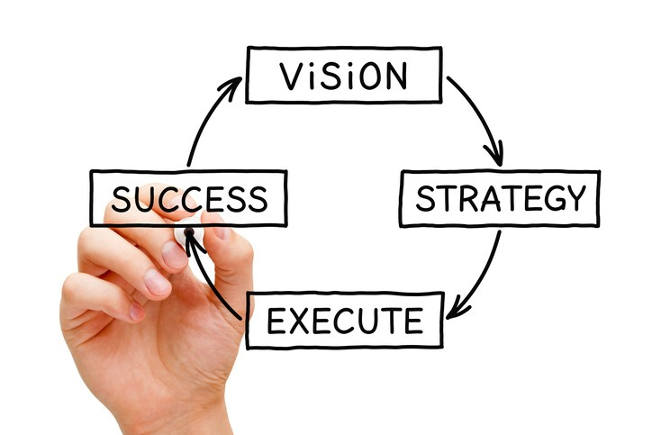
Remember your Vision - how does it relate to your putting together a marketing program?
Go back to your worksheet for session 1.
Your vision will help determine market.
Notes:
As mentioned in previous modules, having a Vision for enterprise is important it helps to keep you focused and help you sort out how best to market your products. When considering marketing it will help you develop the resources and linkages that help you succeed in marketing your products. If you have not already done so, you should re-check your vision statement. Does it need revision to reflect your marketing goals?.

Slide 6
These are a few questions that you should consider:
Who are your target customers and what do they value?
Who are the competitors? Where are they marketing their products?
Can you link your planned/anticipated production with market potential?
What types of market resources do you have? Need?
Other marketing related questions you may have?
Is entry into your target markets feasible? Why or why not?
Notes:
Before we begin it is important to have a common understanding of marketing and some of the terms used. Here are a few. Selling is the act of negotiating and bringing the product to the customers. Marketing is a process by which you raise customer awareness. In a sense your are setting up the environment for customers to recognize need and decide to buy your product.
What do you know about the market(s) for maple syrup products? Are your marketing needs in your business plan? Can you link your planned/anticipated production with market potential? Can you link sap production, with storage, processing and/or bottling capacities?

Slide 7
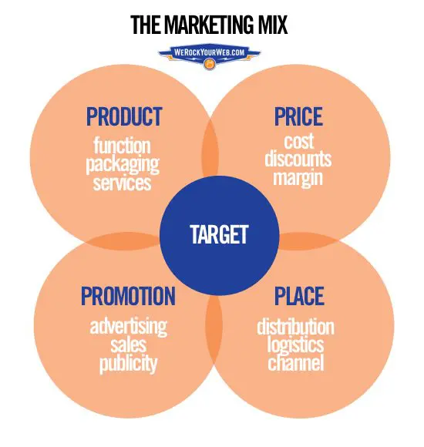
The four Ps
Product,
Place,
Price, and
Promotion
Notes:
It is important to think about your marketing mix strategy - the “four Ps” This is commonly referred to as “marketing mix”. This is the skeleton on which you may hang your marketing activities.

Slide 8
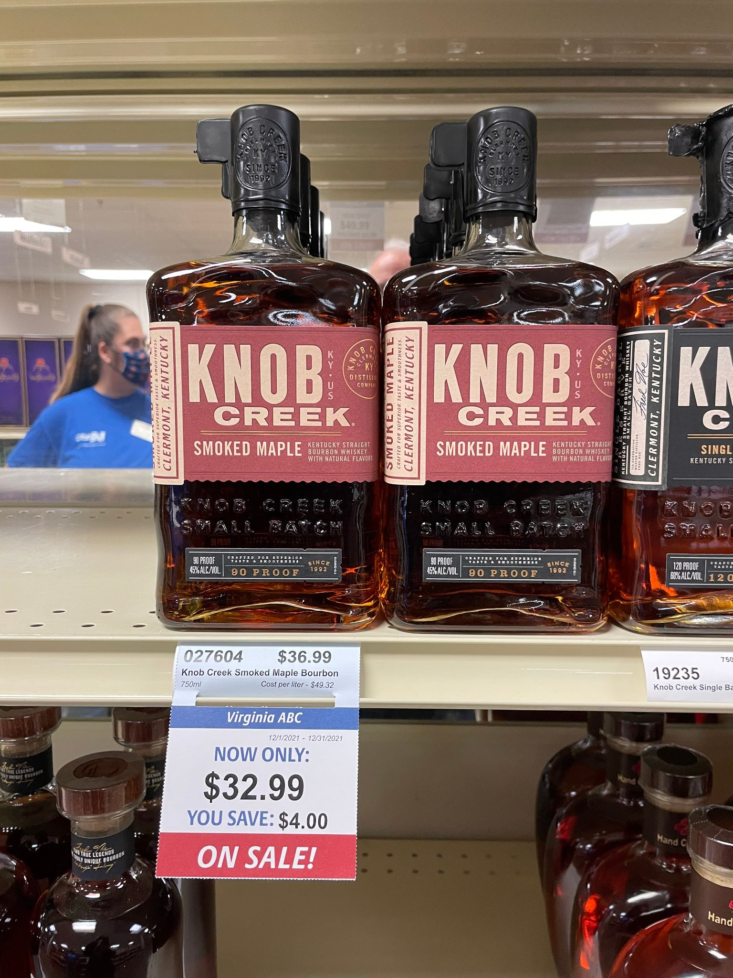
P #1 - Product
What products will you offer?
Are they unique and how?
What do you notice about this example (photo)?
What features will you offer to your customers?
Notes:
You will need to be able to concisely describe your product, and how it differs from the competitors products. A business planning guide - for instance those available from the SBDC - will be most helpful. In this case we see an example of value added products - a maple flavored beverage.

Slide 9
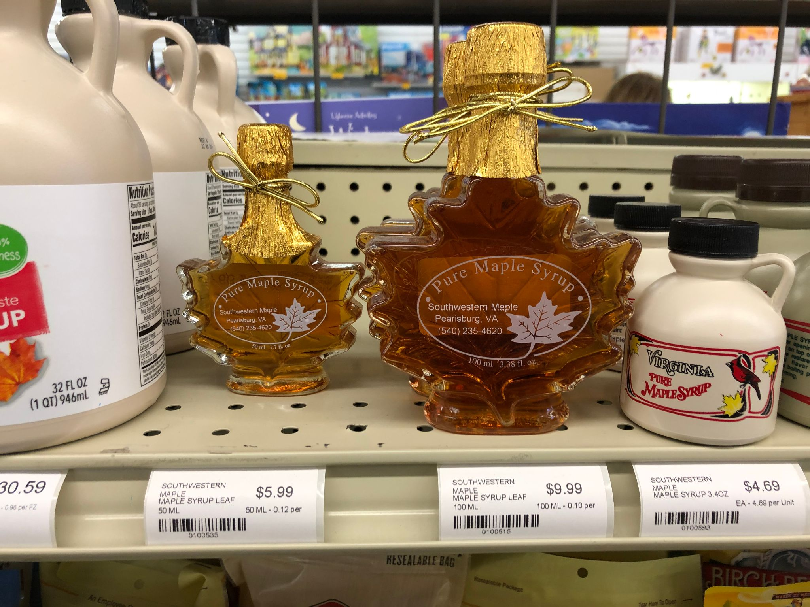
P #2 - Place - distribution and packaging
There are various packaging opportunities - what is best for you and your product?
How do your competitors distribute their products?
What are the current syrup packaging trends?
Notes:
“Place” is simply how will your get your product to your customers? What is your distribution strategy?
We show here two types of packaging - one class and the other plastic. Two deciding factors for customers the type of packaging, and size of container. In this case pint or half pint.

Slide 10
Where do you want to sell your product(s)?
Direct marketing opportunities
Retail and wholesale opportunities
Intrastate commerce (in-state)
Farm stands
Sugarhouse sales
Farmers markets
On-farm restaurants
Catering
State fairs and festivals
At home use (i.e., incorporate in value-added products)
Packed for restaurant use
Wholesale in drums
Consumer-ready (boxed bottles)
Distributor or aggregator
Regional and national warehouses
Value-added products
Interstate commerce (across state lines; i.e., online sales)
Notes:
Again, you may have already answered these questions when forming your vision and mission statements. You may not have responses or you are working on expanding your marketing and branding efforts. Answers to any of these questions (whether now or in the future) will help you identify the exposure and liability risks you may have as you move forward to establish a formal business entity. Take a few moments on the worksheet to document what you know and need to learn about markets for your products.
If you are an existing business and are thinking about expansion, provide information about where you are and where you want to be.

Slide 11
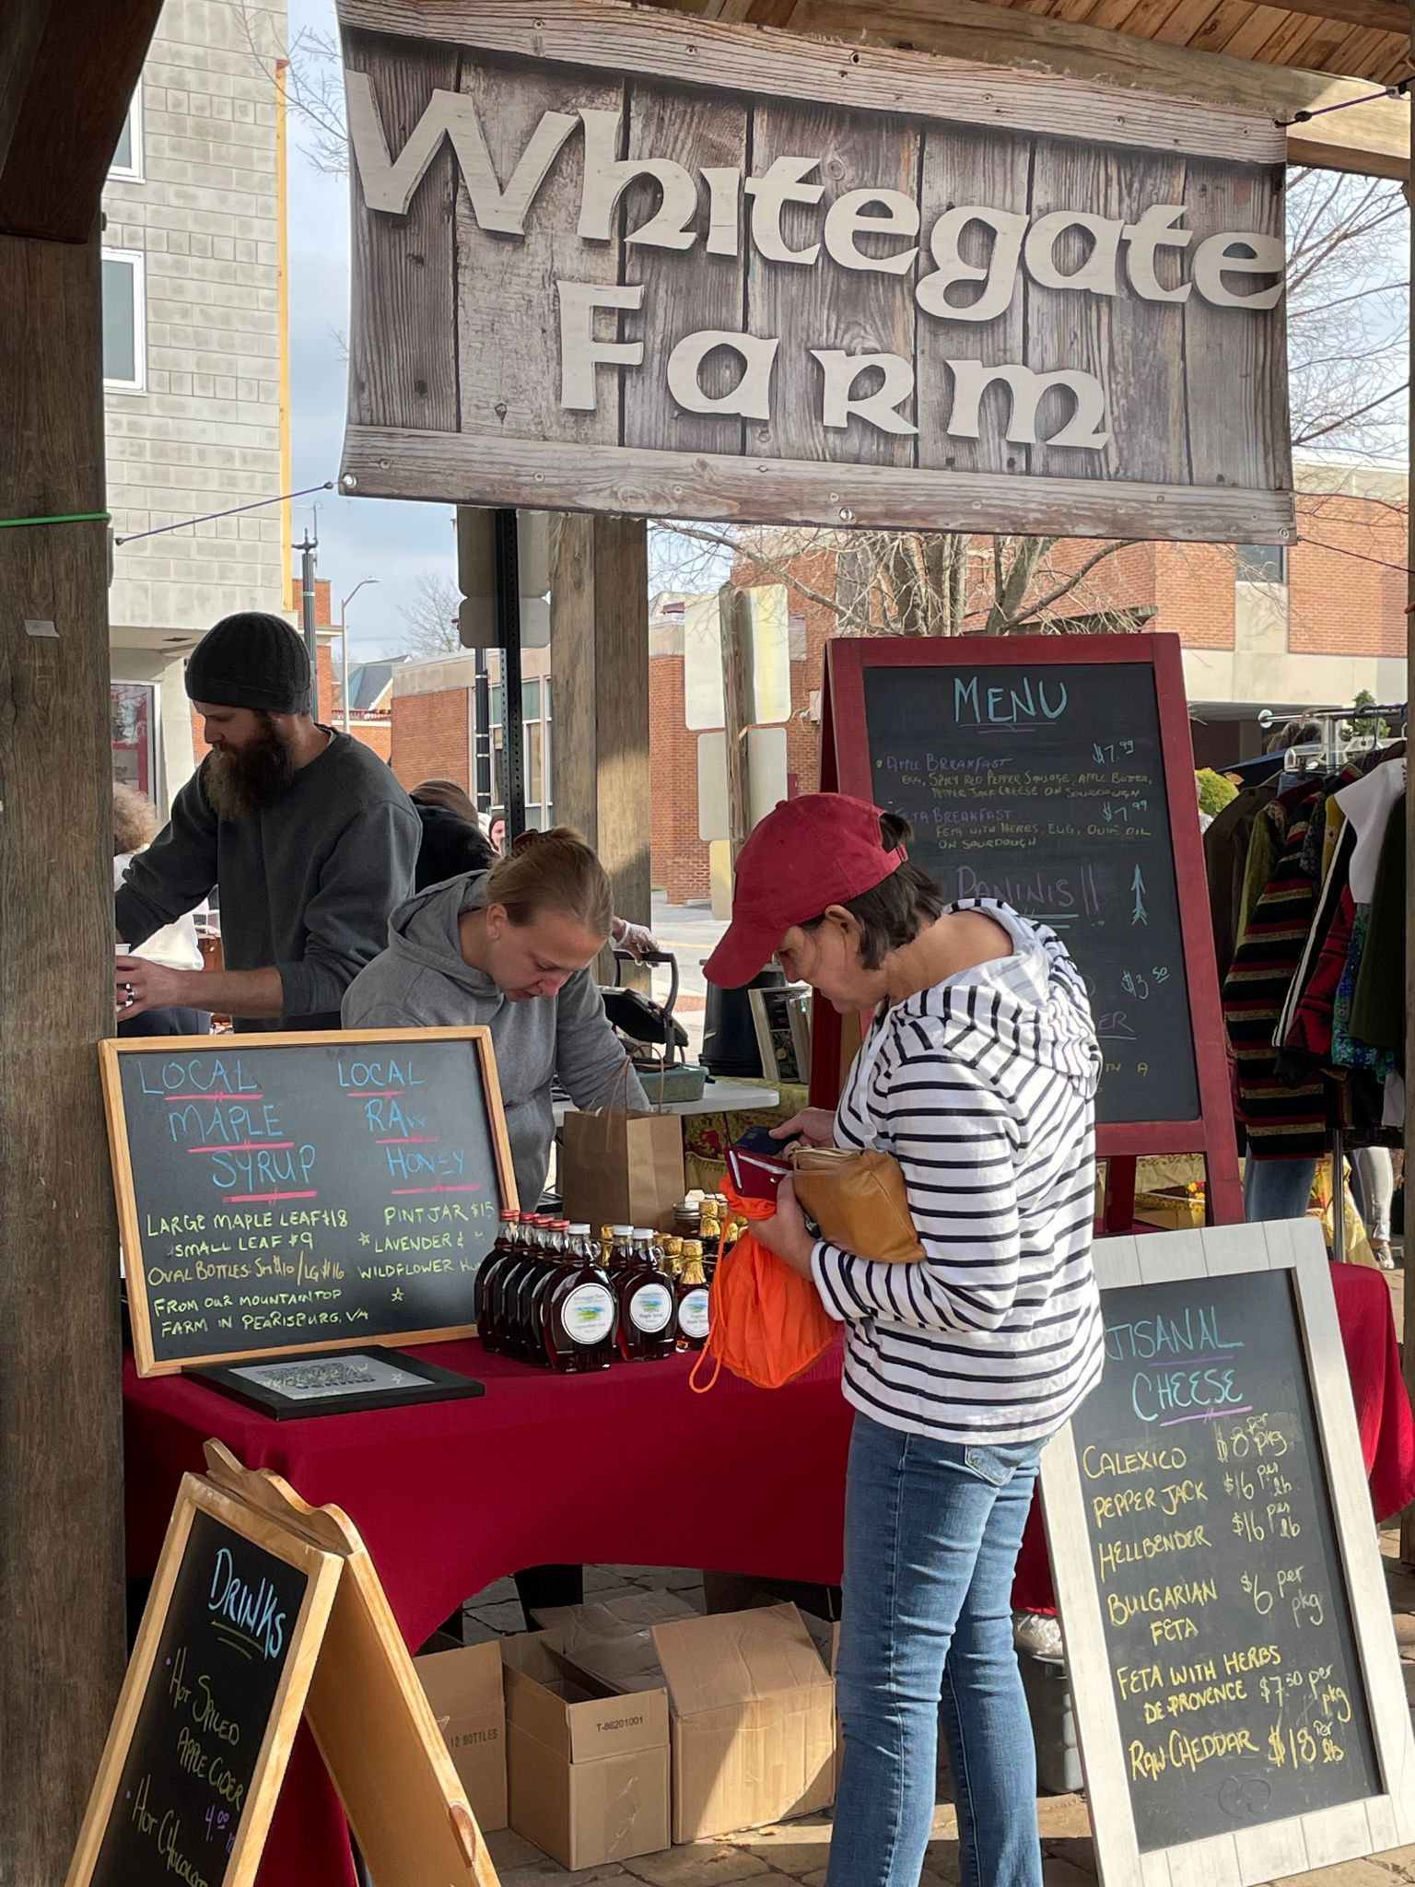
P #3 - Price
Learn about syrup pricing-what are syrup price in the stores that you have visited?
How will you price your product?
Have you looked at pricing in the market?
Have you surveyed store shelves?
Posting pricing helps customer at farmers market make buying decisions
Notes:
A pricing strategy will determine how you will price your product(s). What are the typical markups in the region for maple syrup? Compare your prices with those of your competitors. What is your pricing policy? Do you need payment discount strategies? To learn more see one of the reference by Canella that we list at the end of the session.

Slide 12
P #4 - Promotion
What message will you communicate to buyers or customers? Where will you use these messages?
Where and how is it best for you to communicate with customers about your products?
What information should you include on your labels?
How are your competitors packaging syrup?
How might you package your product?
Notes:
What are your advertising plans? What about direct sales calls? Will you make them? Will you go to a trade fair or exposition?
What about sales channels? Who will be selling your products? What are the priorities of your promotions?

Slide 13
Getting your product to market
Direct to the customer (i.e., roadside, farmers markets, mail order/internet marketing)
Using intermediaries (i.e., you sell to wholesalers, brokers)
Or, those who represent farmers for a commission, but do not take possession or title of your product
Note: Some examples are included on the next slide
Notes:
Finding the best way to get you product to the market, and into customers’ hands is important. Each method has its advantages and disadvantages. You need to examine these methods before you select the one best for you. Your choice may change as your business grows or changes.

Slide 14
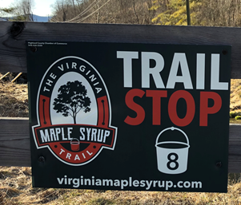
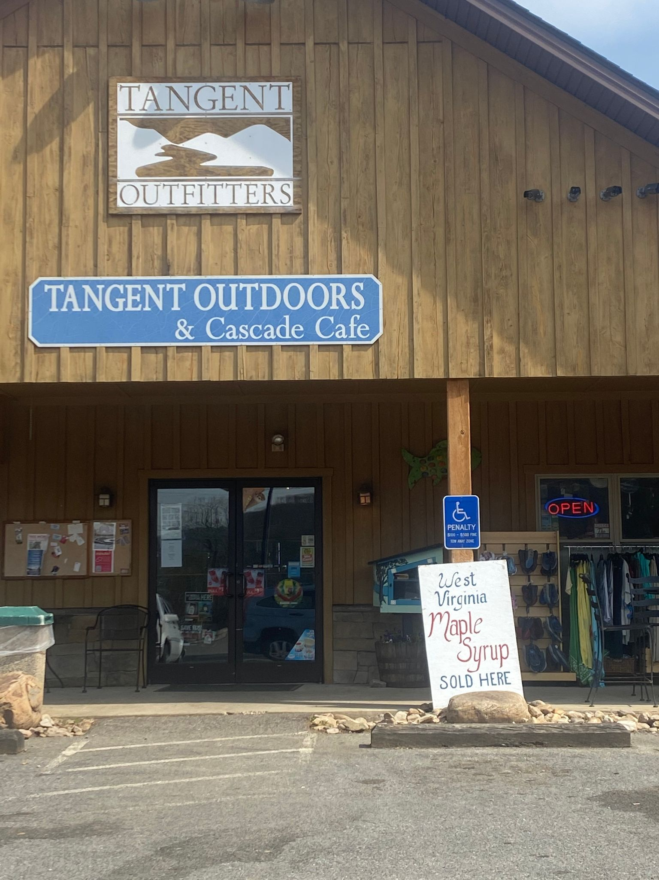
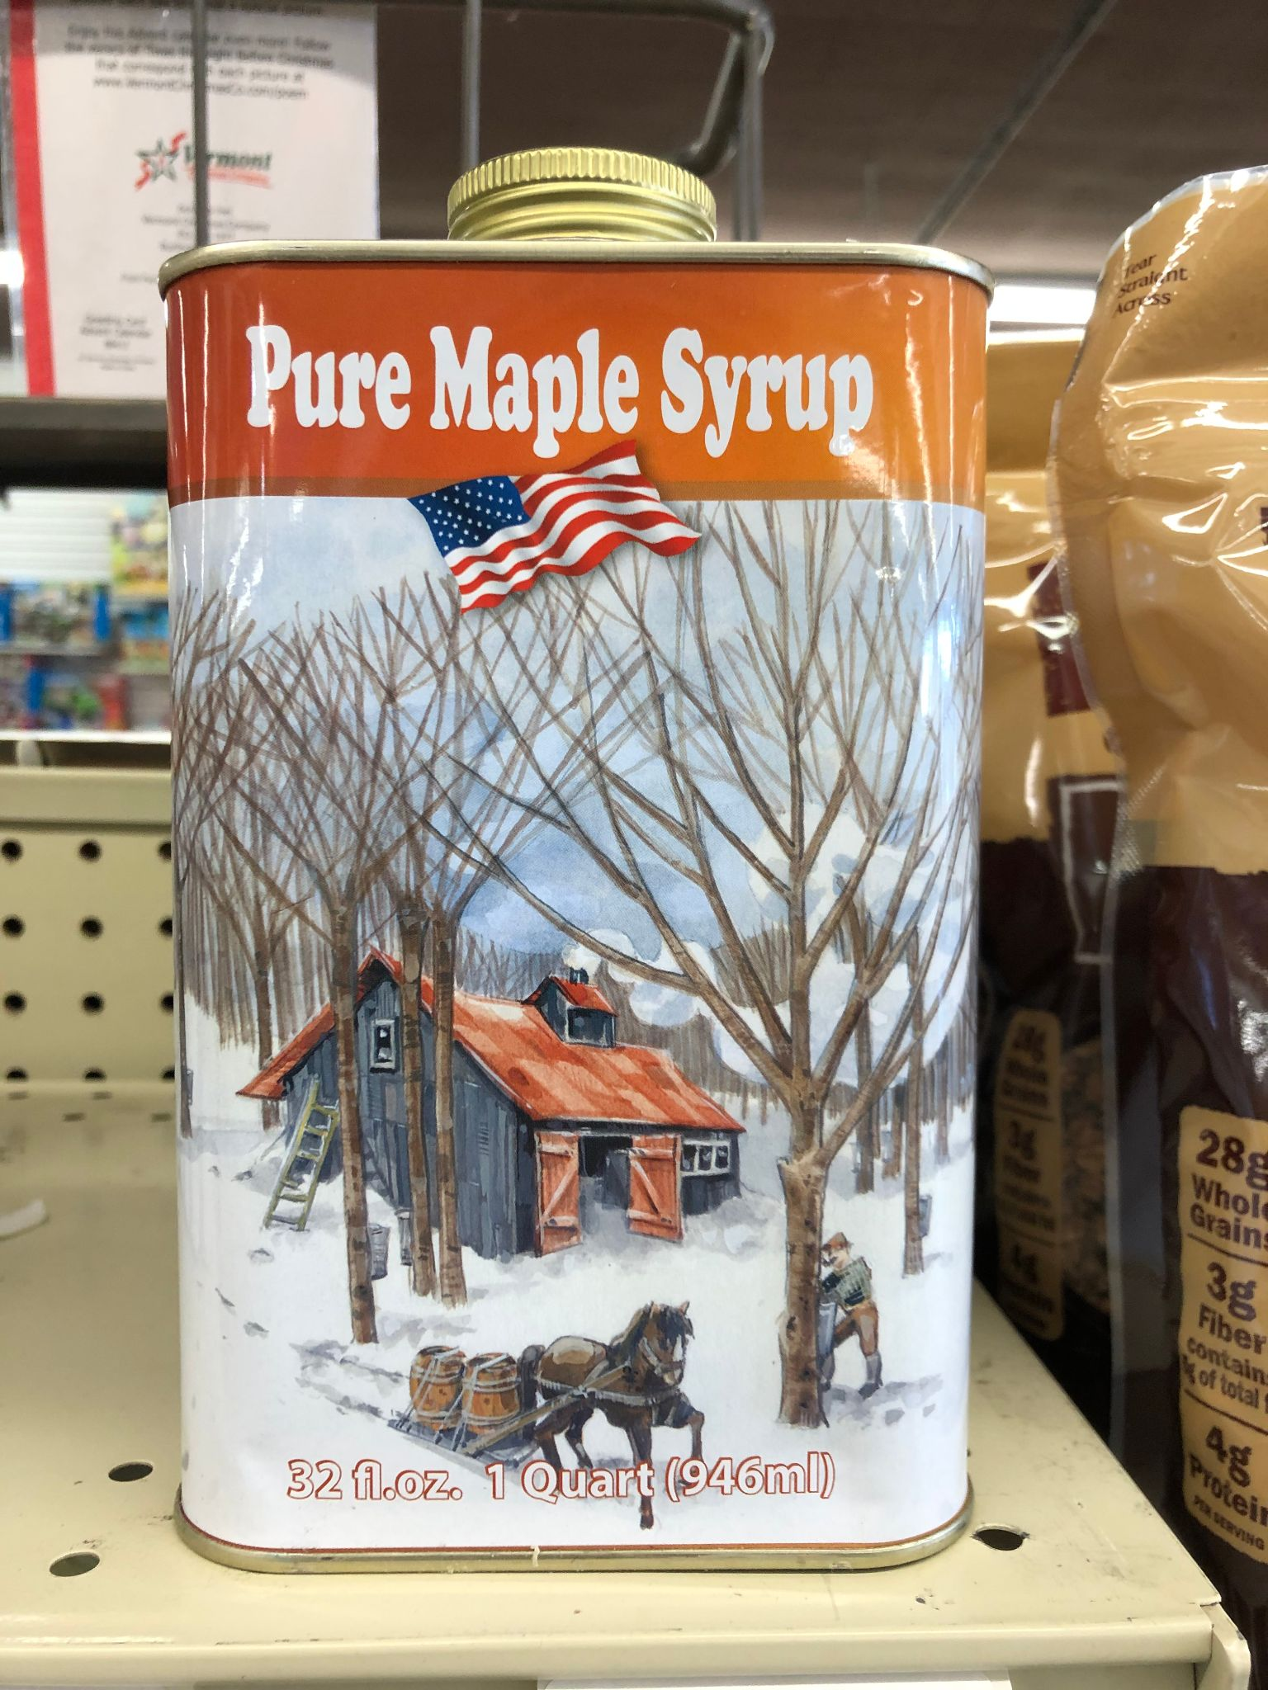
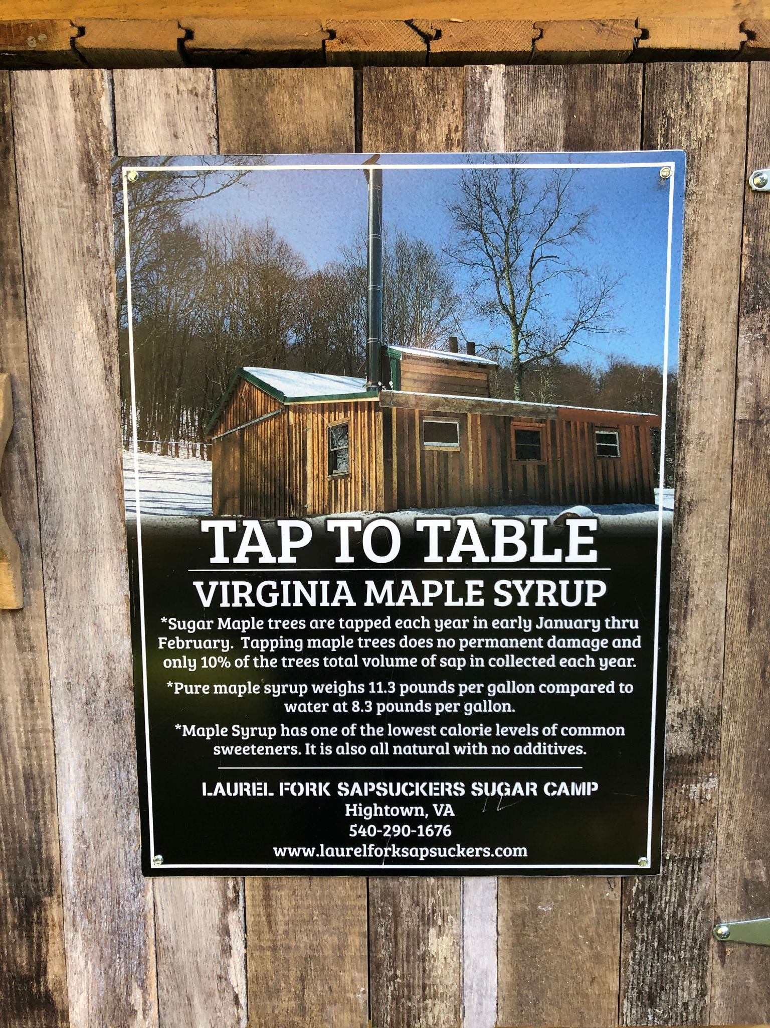
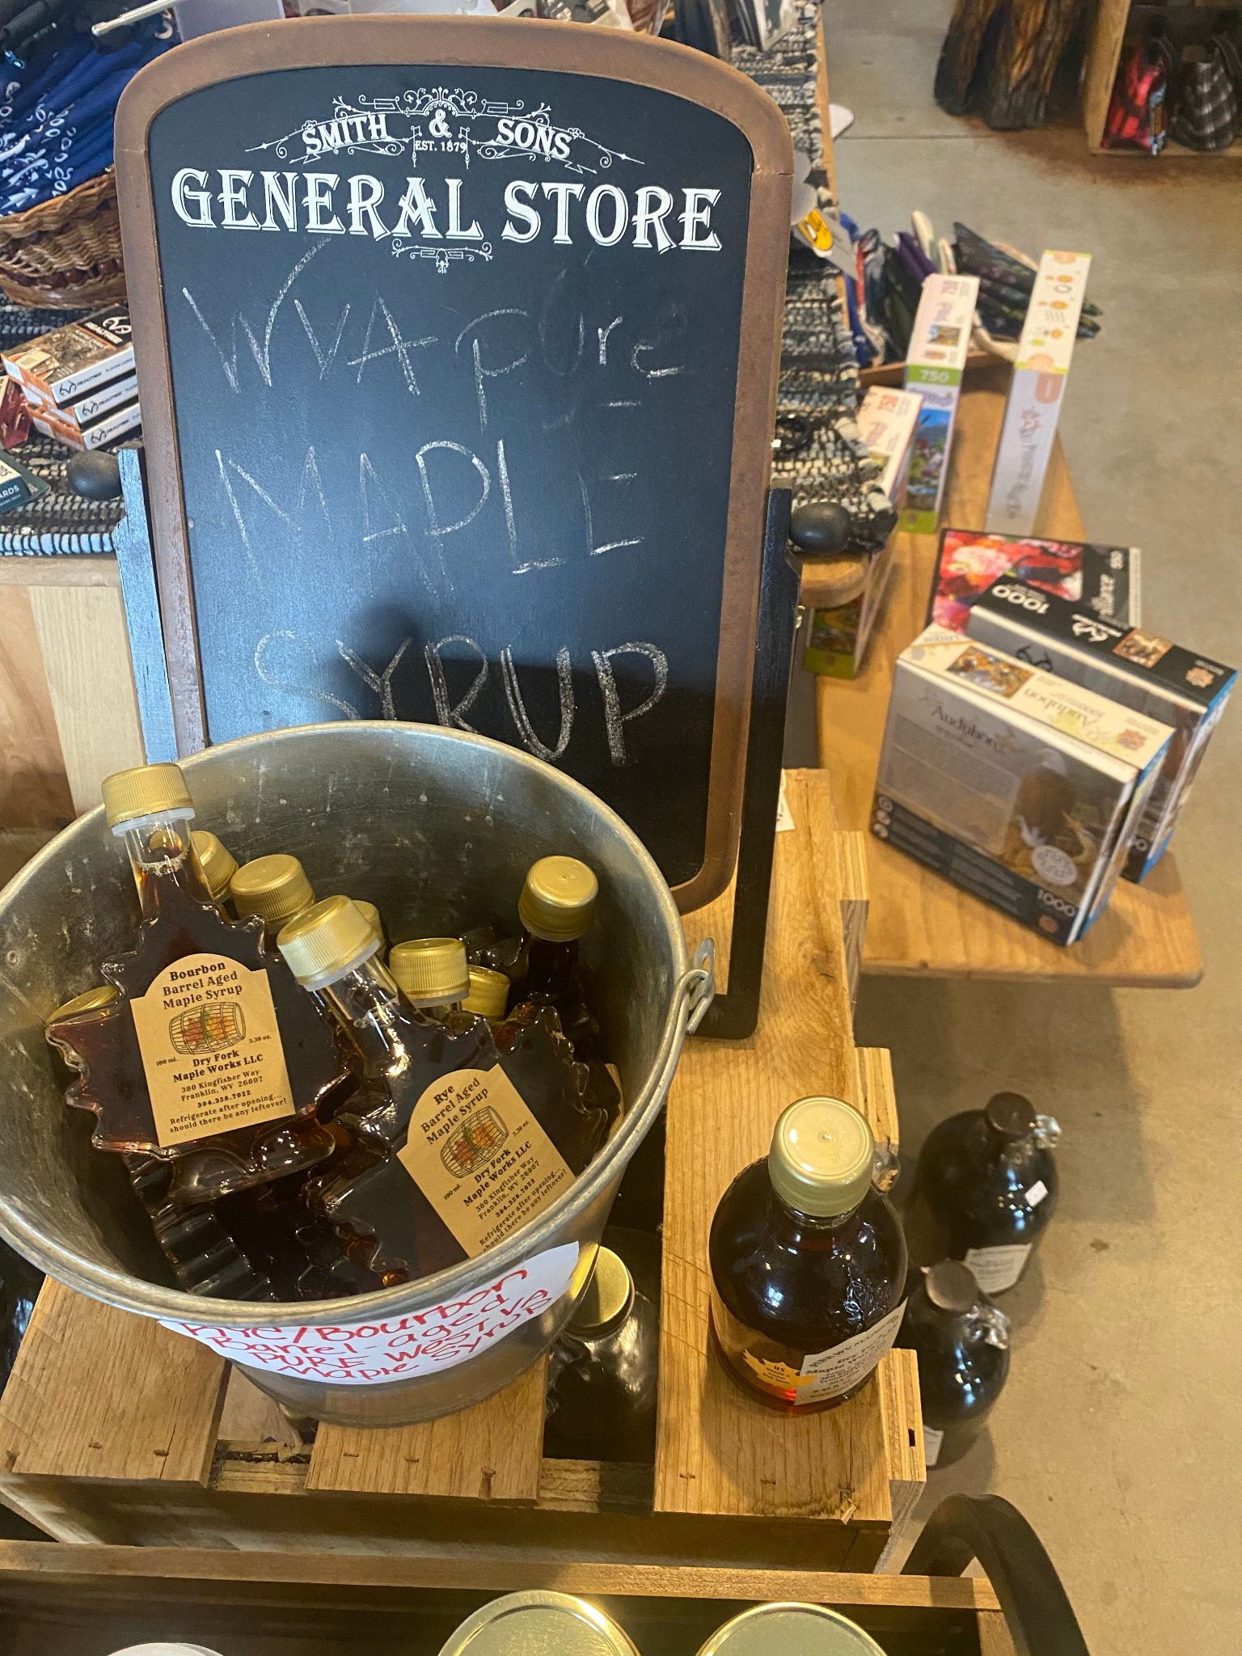
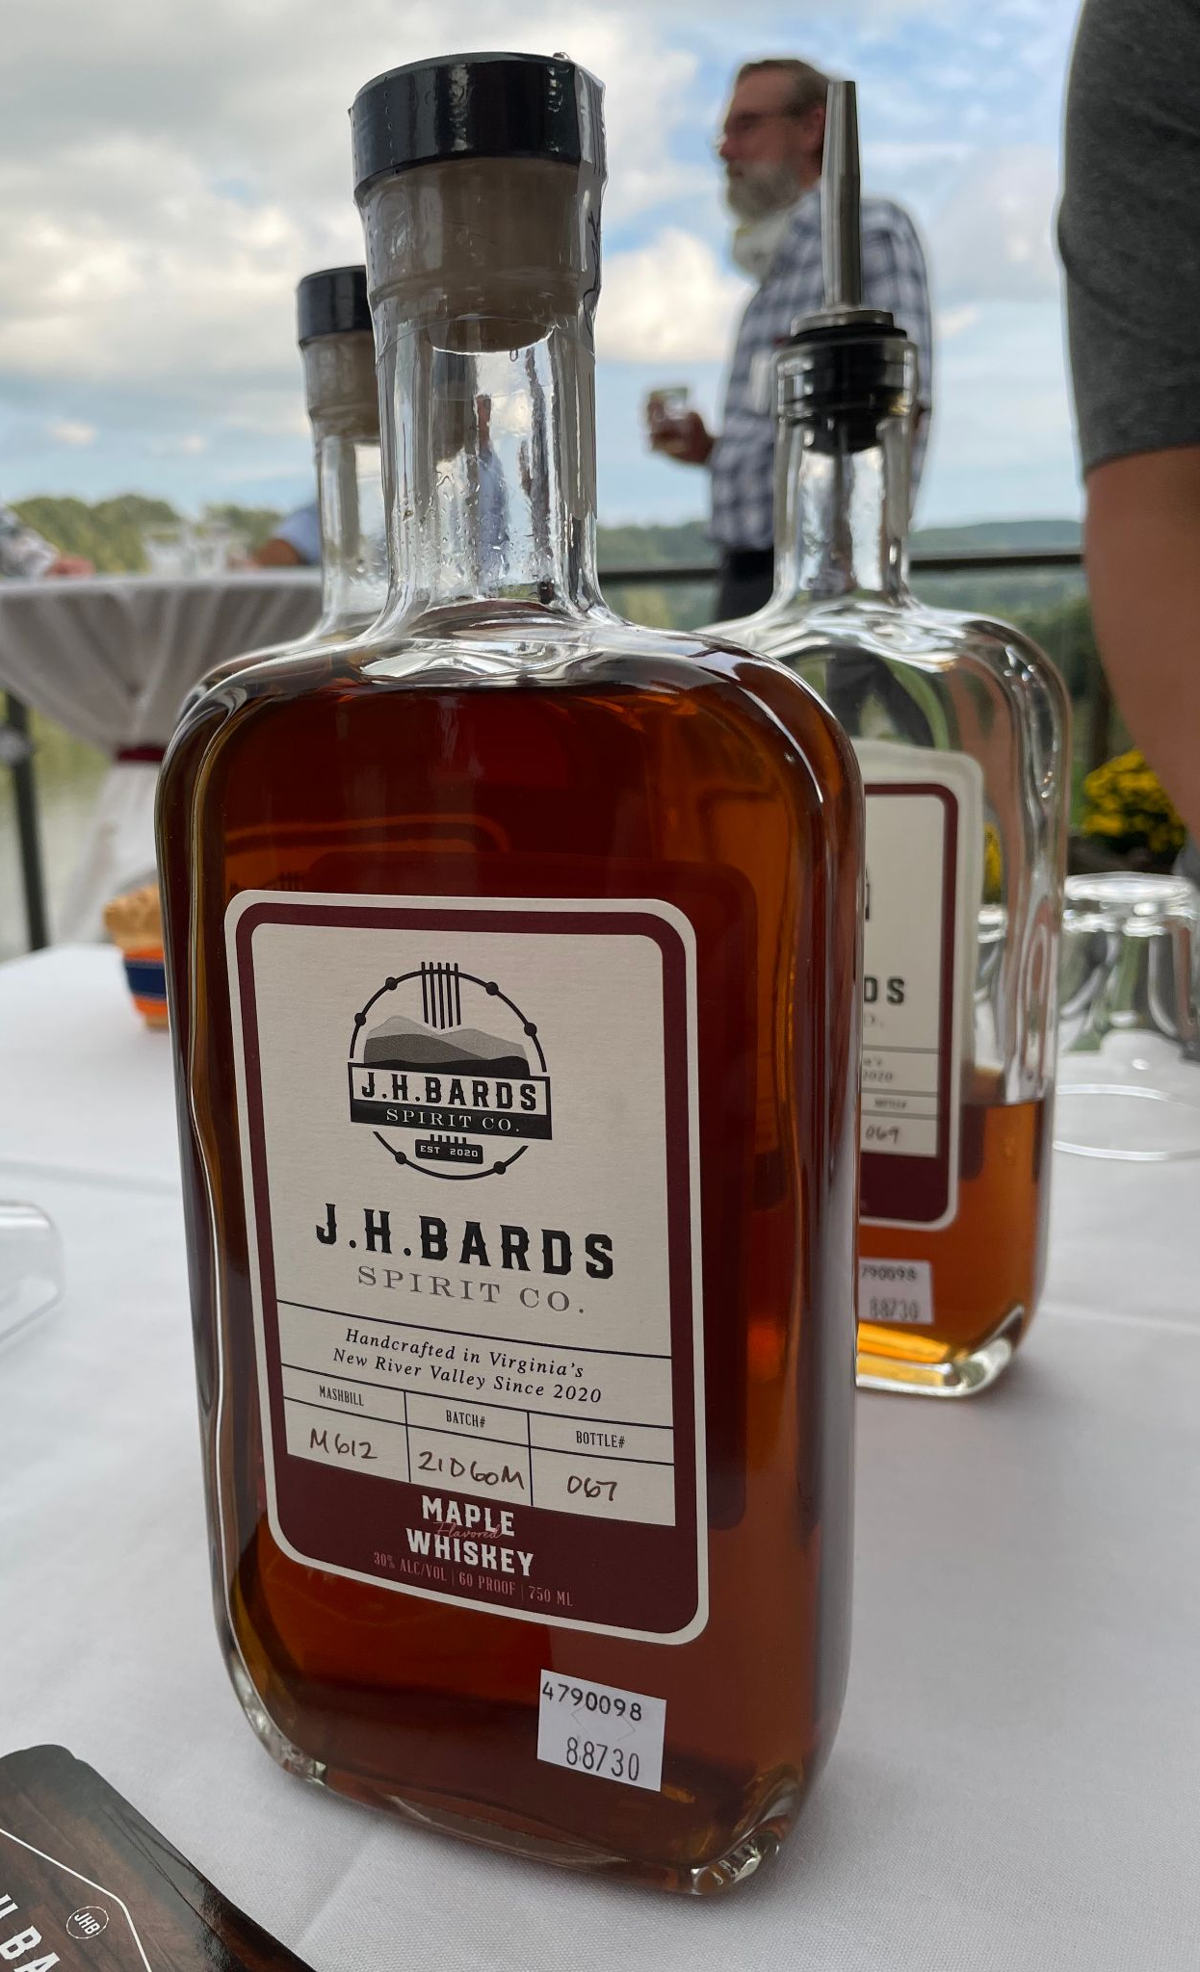
Tin was the dominate package Roadside sales are common Speciality shops and convenience stores
Capital investment
Presentation for in-store Value added - beverages Value added - maple sugar Selling to restaurants
Notes:
Where and to whom you sell your product(s) to impacts business structure based on the amount of risk, liability and regulation. Direct marketing (from producer to consumer) is where you can start your enterprise and your production/sales goals may allow you to remain at this level. Establishing and growing your business is a complex relationship between markets, production, value added and other decisions. Making these decisions will need some research and engagement with your team.
Evaporator represents capital investment—-increased production—more, possibly diverse markets, packaging and label changes, production time, etc. Capital investment could include an RO machine, etc.
An example of a consignment/commission arrangement would be selling your product to the Wild Ramp, a store in Huntington or another vendor who sells your product for you for a set percentage.

Slide 15
Components of a marketing plan include:
Market size and trends
Competitor analysis
Target market(s)
Marketing mix; include strategies for
Product
Price
Promotion
Distribution
Sales strategy
Notes:
A bit of review. You should conduct a SWOT to analyze your strengths and weaknesses of your business as compared to you competitors and determine your success factors. You should now go back to this session’s worksheet and note the outline/basic points of a marketing plan. In subsequent sessions we will discuss market planning.

Slide 16
Marketing plan
Includes description of product, price, distribution, promotion
What is your firm’s niche? Who will buy your product?
What is the demand? Where are your customers located?
Who is the competition?
Sales plan - primary outlets (i.e., farmer markets, grocery stores) and direct sales (i.e., from the farm)
Advertising planned - (i.e., primarily word of mouth)
Market information gathering is an ongoing process
We suggest that you start working on the template (outline) included on the worksheet for this module
Notes:
A marketing plan is most necessary for new products/markets
Look for linkages that save you time and money

Slide 17
Resources you may contact for guidance:
Your mentoring team (staff, family and professionals)
University of Vermont
Virginia Small Business Development Centers (SBDC)
Local chamber of commerce, economic development agencies, and Virginia Tech Cooperative Extension Service
Senior Corps of Retired Executives (SCORE)
Future Generations University (syrup@future.edu)
WVDA Planning Coordinators or VDACS marketing
Notes:
There are several organizations and their representatives, both locally and in the region, that you should consider asking for help or linkages. Don’t overlook your neighbors, other producers, those who might help you market your syrup or other products. Your team may include but are not limited to these.
Regional market development programs/opportunities - Economic Development Authorities, regional buyers and businesses, business incubators (i.e. The Hive, SW Virginia Craft Center, Tamarack)

Slide 18
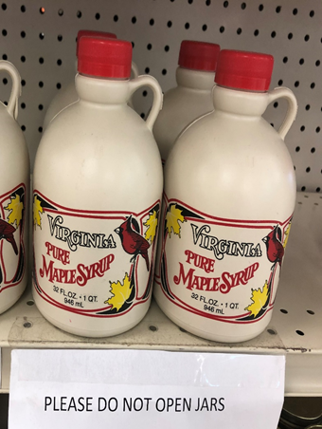
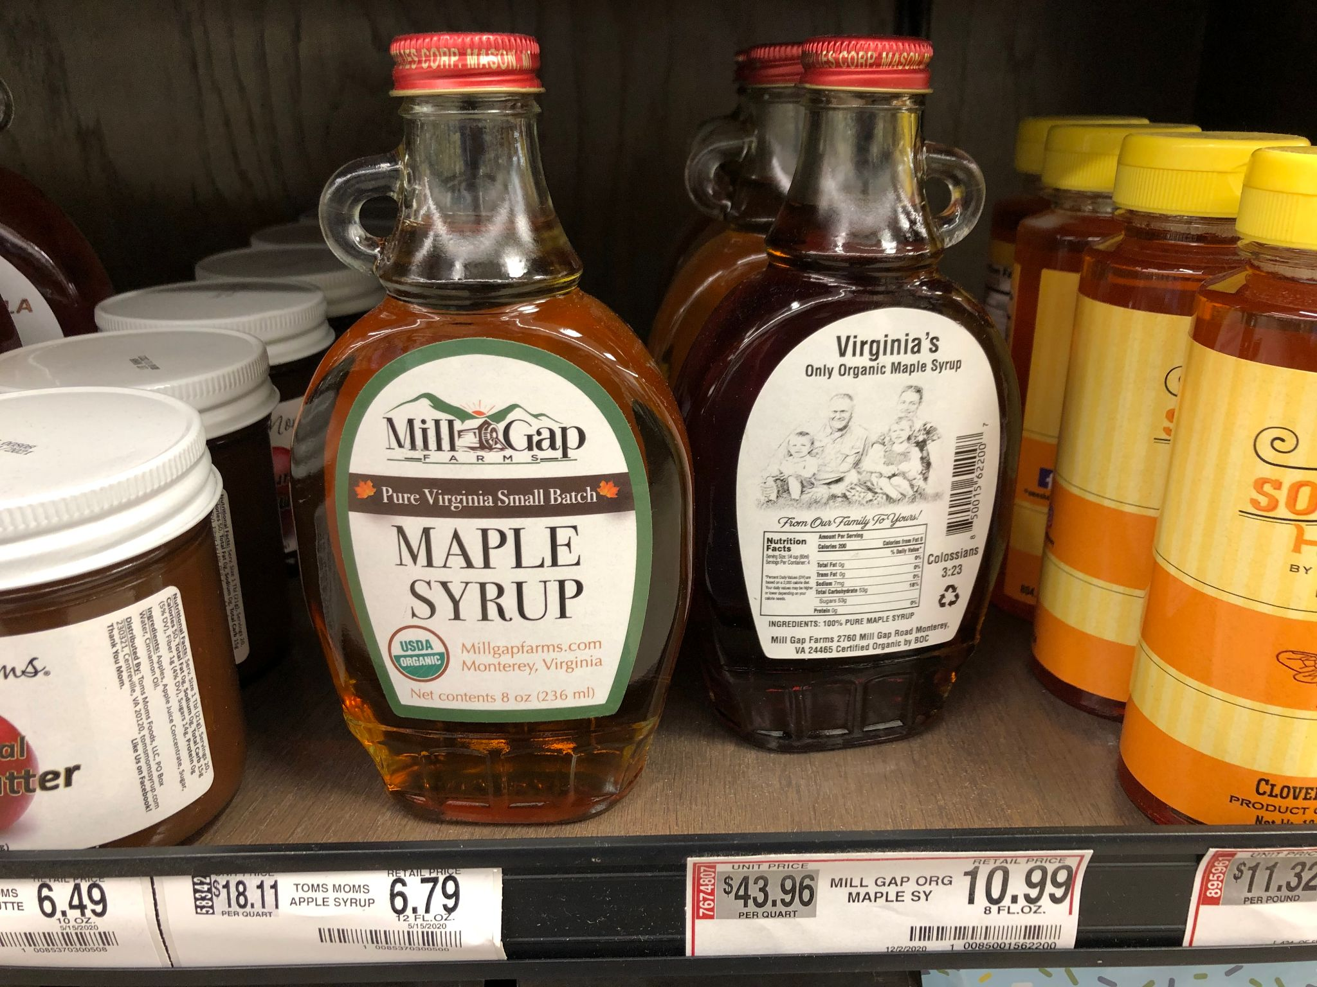
Action Plan
Activity | Yes | No | N/A | Action Plan, timeframe and assignment
Assemble a list of mentors for your enterprise |  |  |  | Ongoing
Conduct SWOT Assessment for your maple enterprise |  |  |  | See Module #2
Develop a marketing mindset for your maple enterprise |  |  |  | This Module (#3)
Develop your marketing strategy/mix
Online and social media strategy
Notes:
What are the next steps? Determine the options for getting your product to market. Remember to incorporate your draft marketing plan worksheet into your business plan binder; you can always go back and adjust based on your marketing results/targets

Slide 19
Some helpful sources:
University of Vermont. Maple Business Planning Tools and Publications including “Maple Business Plan”, Maple Management Biz Modules. You can find these and other resources at this link: https://www.uvm.edu/extension/agriculture/maple
Perry, J. and S. Childs. 2012. Beginning or Expanding Maple Syrup Operations as a Profitable Business. NY Farm Viability Institute. Cornell University. 43 p.
Gloy, A. 2004. Putting Market Information to Work: A Marketing Planning Guide. Extension Bulletin EB-2009-04 Cornell University. 29 p.
Minnesota Institute for Sustainable Agriculture. 2018. Building a sustainable business: A guide to developing a business plan for farms and rural businesses. SARE Handbook 6. College Park, MD. 276 p.
These are resources are representative of those you may find useful. We suggest contacting the agencies mentioned earlier to learn of other available resources.
Notes:
You will find several useful resources through the linkages that you make, and through several organizations that are focused on maple-based enterprises or enterprise development in general. Here are four sources that we think may be a starting point for developing your marketing strategy.

Slide 20
Did I learn what I needed to know?
Please complete the Evaluation Form for this module
This will help us make sure that your needs have been met, and that future training modules will be useful to you
Are there any other topics in this area for which you would like information?
Thank you for for your participation
Notes:
Your feedback will help us provide useful sessions on topics that are important to you and others working in the maple syrup sector.

